Slide 1
Brain Tumor Image Segmentation with MASK R-CNN Algorithm
Samoua Alsamoua, No:422705
Software Engineering Department, Karadeniz Teknik University, Trabzon, Turkey.

Slide 2


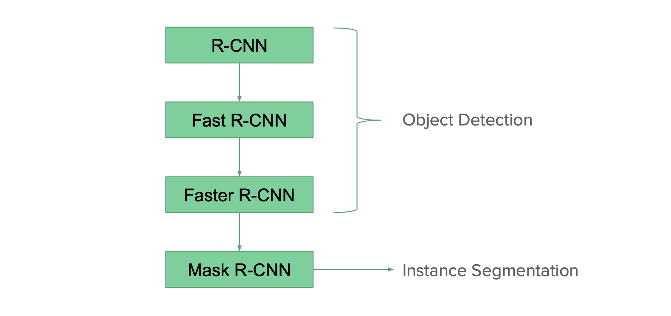
INTRODUCTION:
Their approach was designed to efficiently detect objects in an image while also, simultaneously generating a high-quality segmentation mask for each instance.
At the time advances in object detection and semantic segmentation were being driven by powerful baseline architectures such as Fast R-CNN, Faster R-CNN and Full Convolutional Networks. Although, instance segmentation was not yet solved using these baseline architectures.
These decided to take the same approach for their instance segmentation problem by extending the Faster R-CNN architecture. They did this by adding a branch for predicting an object mask in parallel with the existing branch for bounding box recognition.

Slide 3
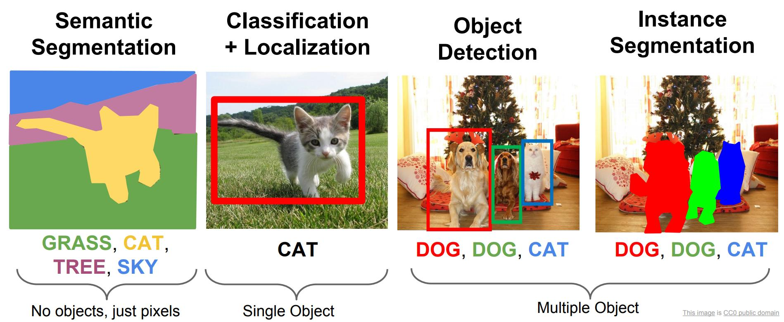
INTRODUCTION:
Types of Computer Vision Tasks

Slide 4
The main problem
Brain Tumor.
Magnetic resonance imaging (MRI).
Several different types of algorithms.
Tumor Detection.

Slide 5

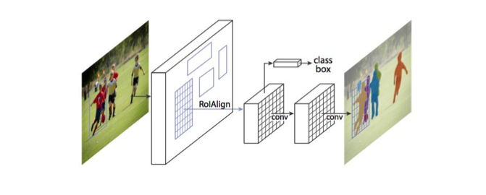
Overview of Mask Region-based CNN (RCNN)
Mask R-CNN is an object recognition algorithm.
Mask R-CNN takes the same two-stage procedure that Faster R-CNN takes.
The first stage which is identical, is RPN (Region Proposal Network).
The second stage, in parallel to predicting the class and box offset, also outputs the binary mask for each region of interest.
This is different from most other systems at the time, where classification depends on the mask predictions.

Slide 6
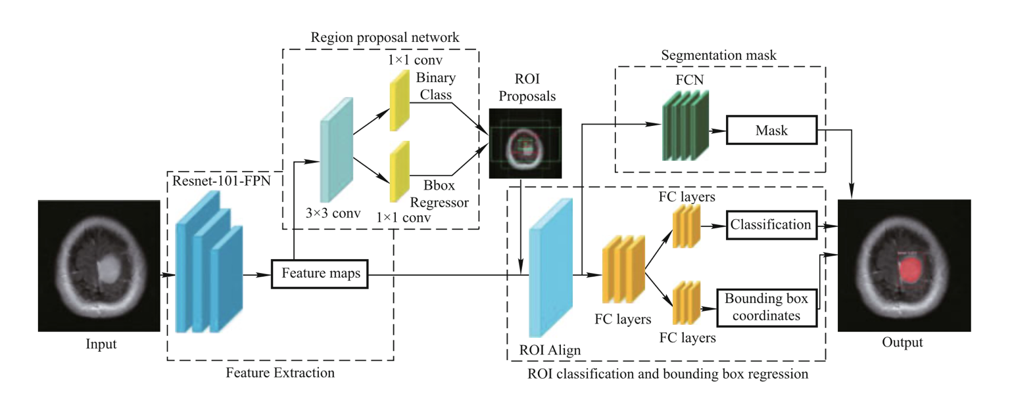
Mask R-CNN
Backbone+RPN
Parallel heads for box regression and classification
RoIAlign

Slide 7
Mask R-CNN
Preprocessing
Tumor localization and segmentation using Mask RCNN
Feature extraction
Region Proposal Network, RPN
Region of Interest, ROI
Segmentation mask

Slide 8
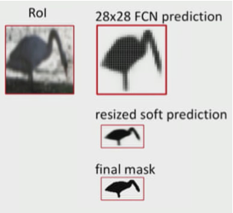
Binary Mask Prediction
Dimension: Km2
K represents for class number
m2 represents the spatial resolution
Mask is resized to fit the shape of the original objects

Slide 9
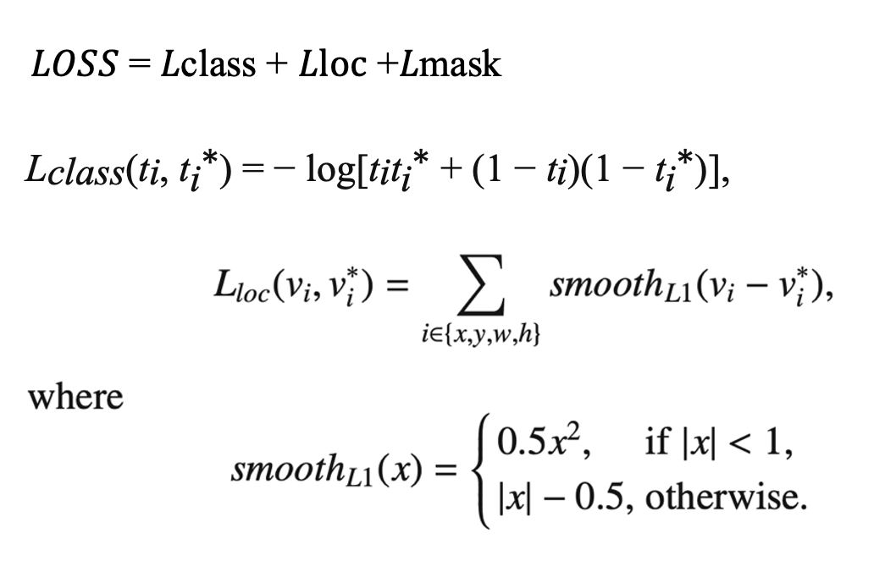
Mask R-CNN Loss Function
Classification Loss
Multiclass cross-entropy loss
Bounding Box Loss
Smooth L1 loss between ground-truth bounding boxes and predicted bounding boxes
Smooth L1 loss is a robust L1 loss that is less sensitive to outliers than the L2 loss
Prevent gradient explosion
Mask Loss
Only defined at Kth class, where K is the class with ground-truth label
Defined as average binary cross-entropy loss
Thus, masks a crosses classes do not compete
■ Good for instance segmentation

Slide 10
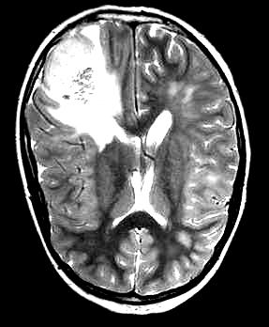
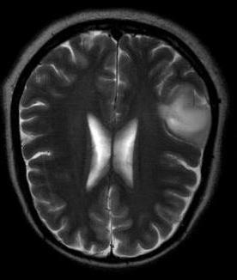
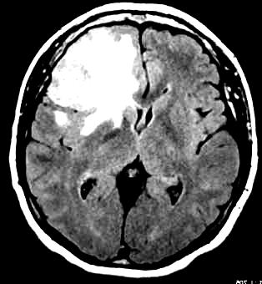
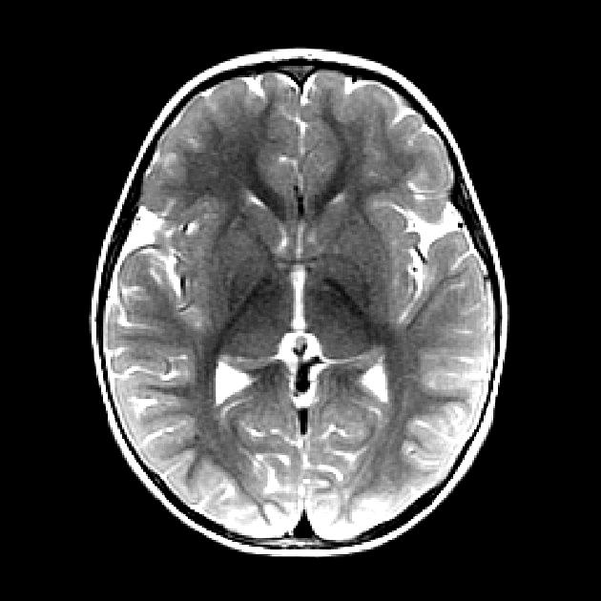
Dataset
The dataset is taken from the Kaggle site.
It constitutes a total of 1500 MR images with tumor and 1500 MR images without a tumor.

Slide 11
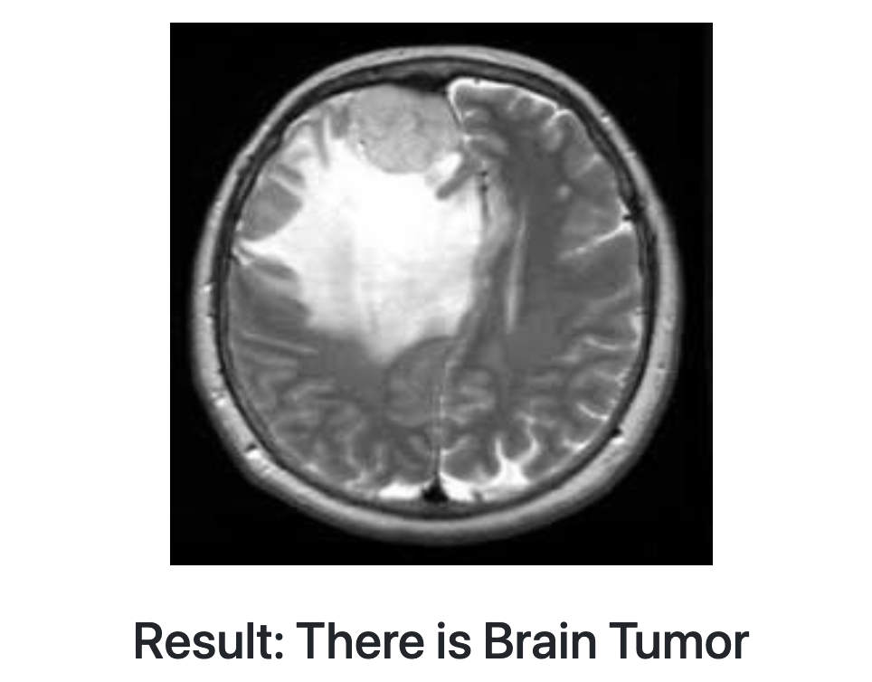
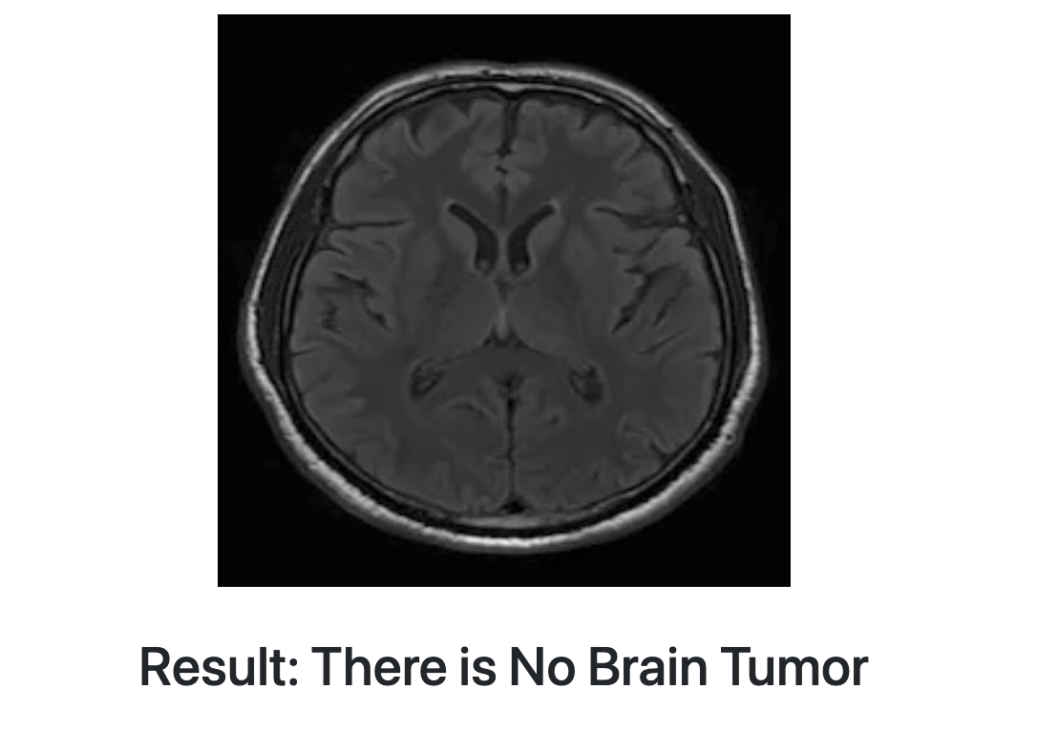
experiments and results
Keras and TensorFlow libraries.
Mask R-CNN.
Kaggle dataset.
High-scoring results.
Tumors detection.

Slide 12
CONCLUSION
In this letter, we have introduced a Mask RCNN model for the precise segmentation of brain tumor from the MRI images.
We showed the significance of Mask RCNN for brain tumor segmentation.
The results illustrate that the proposed method precisely delineates the tumor region and serves as a effective automated tool for diagnostic purposes.

Slide 13
Thanks

